Slide 1
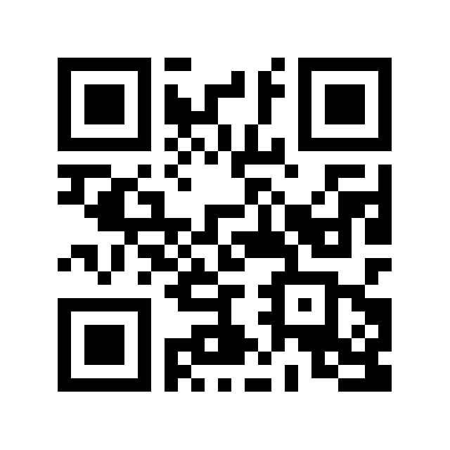
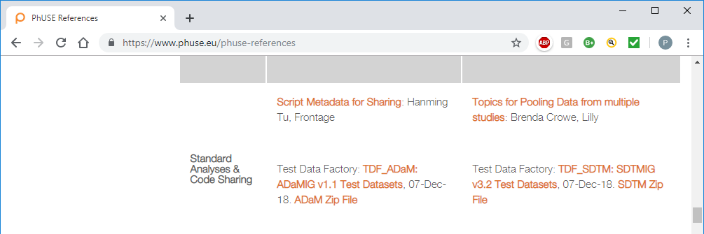
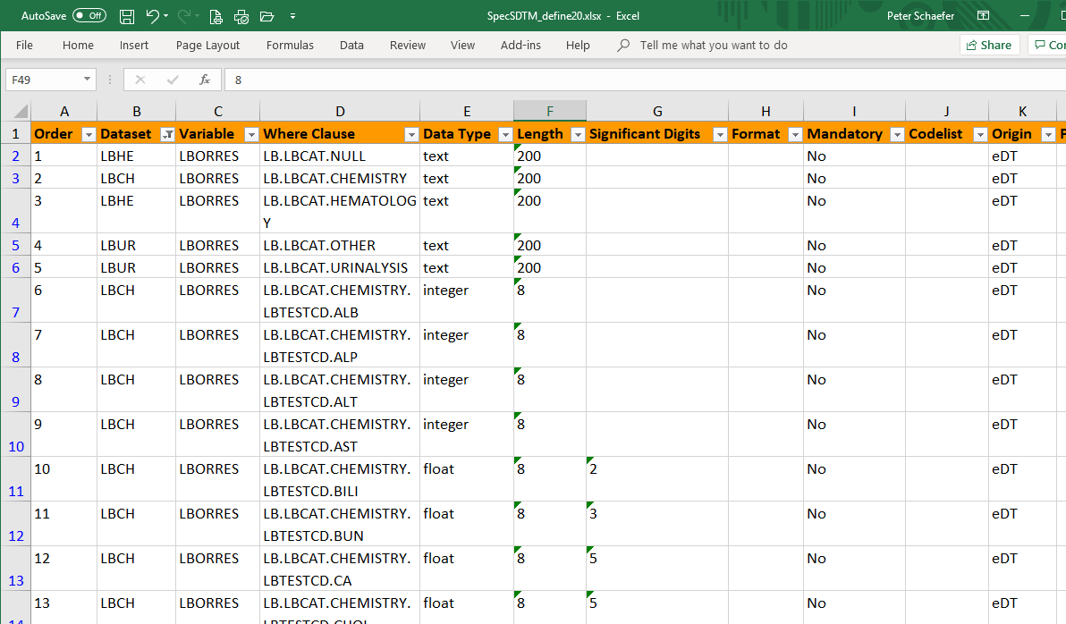
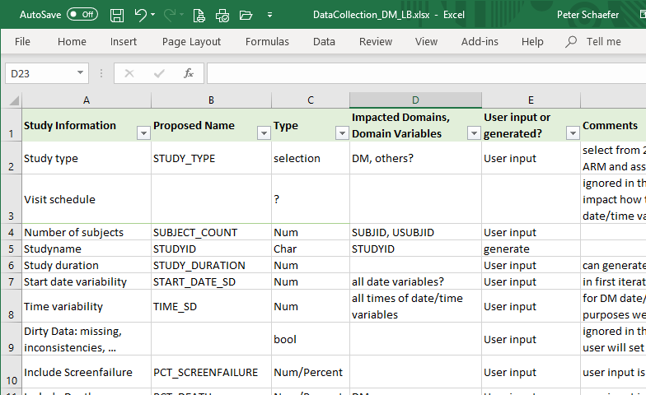
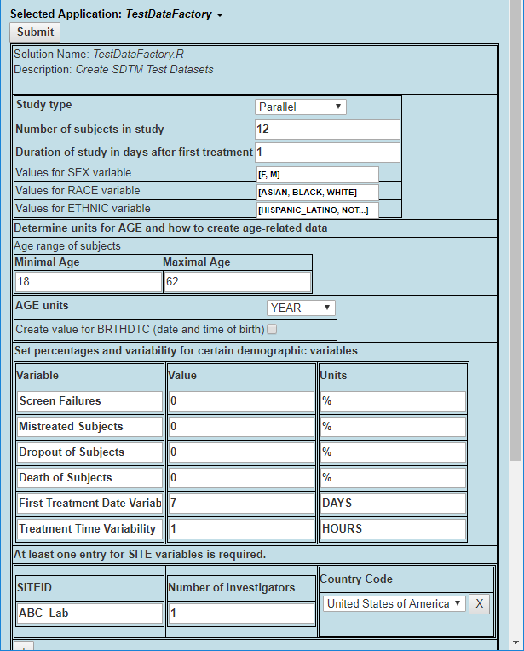
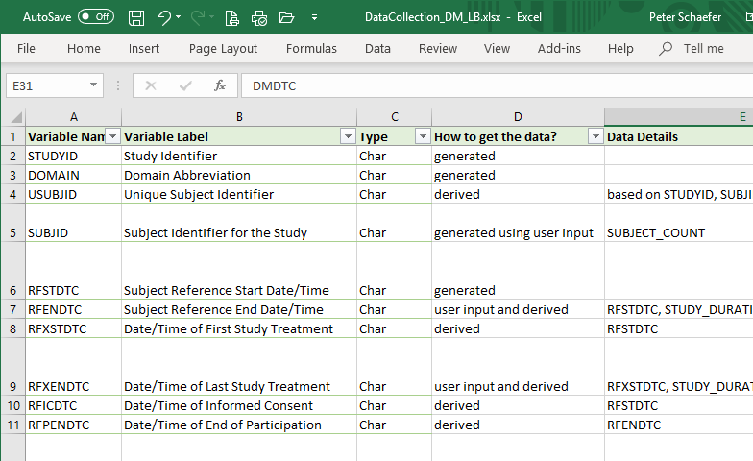
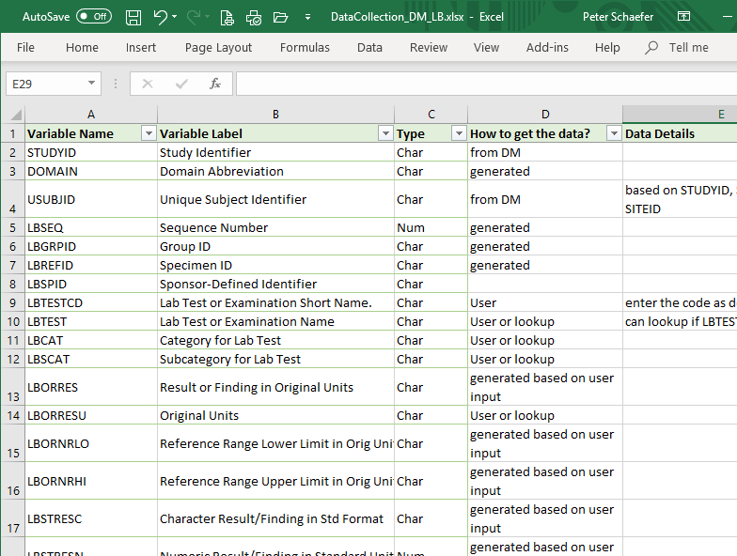
TDF – Overview and Status of the Test Data Factory Project
Nancy Brucken and the TDF Team
The TDF Team
Nancy Brucken, CSG Inc
Jessica Dai, Vertex
Dante Di Tommaso, Omeros
Peter Schaefer, VCA-Plus
Cynthia Stroupe, UCB
Test Data Factory is one of six projects within PhUSE’s Standard Analyses and Code Sharing Working Group. Suitable test data are an essential part of software development and testing. The objective of the TDF Project is to provide CDISC-compliant data sets to empower statistical programmer and software developers. Developers should be able to customize fundamental aspects of test databases.
Previously, the TDF Project team has published two data packages based on SDTM and ADaM data sets published in a CDISC pilot. Now the TDF team have begun to implements SAS and R code that simulates a clinical trial database based on user configuration.
PhUSE is a volunteer organization that relies on community contribution to progress initiatives such as TDF. Speak with us about how the TDF could benefit from your expertise.
Get the Poster
Scan this
QR CODE to download a copy of this poster.
Completed Phase 1: Published SDTM and ADaM Test Data Packages
The TDF team has published two test data packages based on CDISC Pilot datasets:
22 SDTM datasets were updated and documented, including define.xml
10 ADaM datasets were updated and documented, including define.xml
Waiting to be used, so we will get feedback
Available at https://www.phuse.eu/phuse-references
Out-of-scope:
Update of CRF, protocol
Creation of additional datasets
Working on Phase 2: The Vision for the TDF Project
What if we could ask a user to describe what kind of test datasets would be required? Then have some software that creates these datasets? Such as SDTM or SEND datasets that are required for testing a program or a process, with consistent data across domains and optional features like outliers or missing data? And maybe as a bonus the corresponding ADaM datasets?
Creating CDISC test datasets is the idea behind an interactive “Test Data Factory” tool, which is essentially the big-picture vision of the TDF project:
User enter details about the required test data in some appropriate form (UI, Excel,…)
A software program (the “TDF Tool”) generates study dataset based on this input
User gets CDISC-compliant test datasets generated by the TDF Tool
The Roadmap towards a Test Data Factory Tool
The TDF team is working towards a Test Data Factory tool in three steps:
Step 1: Input Requirements Analysis
The basis for TDF is knowing what test datasets the user needs: Therefore the team works through each SDTM domain and each variable to understand whether the user has to provide input, which input is required, and how the user input will impact the generated test datasets.
As a starting point, the TDF team is working on the DM and LB domains.
Step 2: Formal User Input Specification
A formal specification of the required user input is the first step towards an implementation of a TDF tool. Options for formalized user input formats are Excel files or the user interface of some interactive software.
Step 3: TDF Tool Implementation
The TDF team has not decided how to implement the TDF tool. We see two main alternatives:
Scripts that each user can execute and modify as required
A “product” that each user can use (desktop installation or SaaS) and that executes configurable scripts.
At this point, still open questions …
Access to CDISC specification for datasets?
SAS, R, Python, or what?
Ownership?
Maintenance?
Excel file (similar to the define.xml specification in P21)
Study Information
Hardware Requirements
Licensing cost
Validation
Integration
LB Domain
Excel or User interface or both?
User Interface (desktop or online platform)
CDISC versions support
DM Domain
Lack of flexibility
Hidden Cost
21 CFR Part 11
Data Standards
Need to share
How to keep validated?
Updates/Maintenance
Summary
The TDF project exists to provide CDISC test datasets as an important contribution to the development and deployment of CDISC-based solutions. Publishing the first SDTM and ADaM packages based on updated CDISC Pilot datasets was only a first step.
Certainly, the idea of a software tool that enables users to ‘generate’ test datasets – a really interactive “Test Data Factory” – is somewhat of a dream. However, the technology is available and similar concepts have been used in other application areas. So, we are progressing according to plan and would welcome your contribution.
Contact Project Lead: Dante Di Tommaso, dditommaso@Omeros.com

